Slide 1
Data Science Laboratory Department of Mechanical and Industrial Engineering Ryerson University
On the Use of Hidden Markov Model
to Predict the Time to Fix Bugs – Part II
Mayy Habayeb, Syed Shariyar Murtaza, Andriy Miranskyy, Ayse Basar Bener
Feb 16th, 2018
Notes:
1

Slide 2
Outline
Where I Left Off
Looking Under the Hood
My Experiment
Dataset
Updated Results
Notes:
Mention Objective

Slide 3
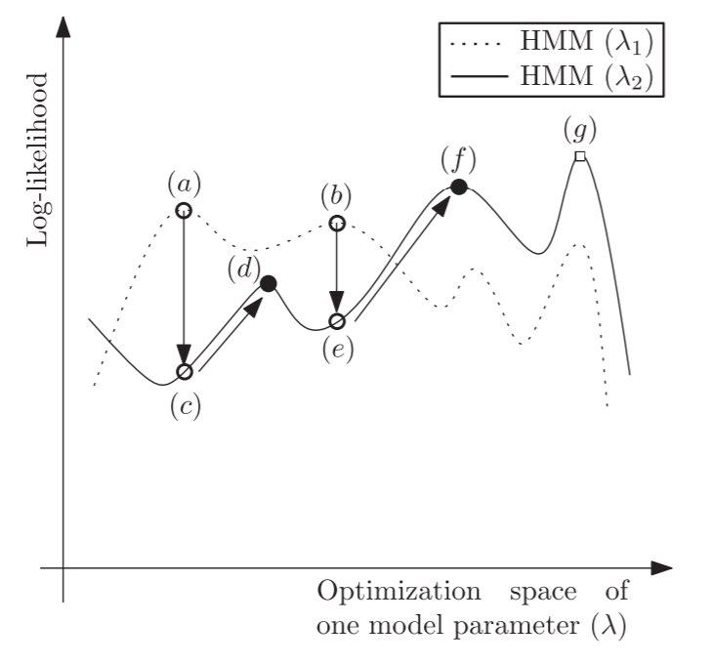
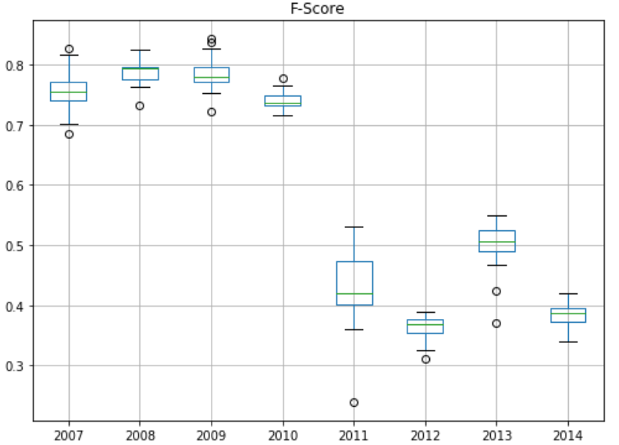
Where I Left Off
Claimed its difficult to replicate results because:
[1] Khreich, Wael, et al

Slide 4
Looking Under the Hood
HMMlearn
Cause of variation: Emission matrix initializations
Manually initialized all parameters
Emission Matrix
Transition Matrix
Start Probability
Made sure they are properly initialized

Slide 5
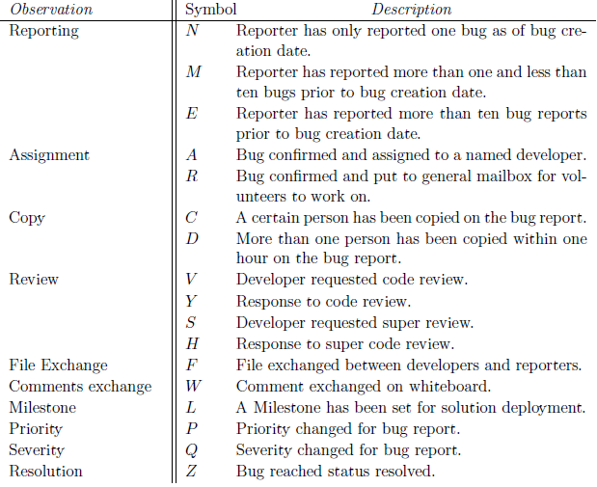
Looking Under the Hood
Mayy’s code
HMM is trained using 16 symbols not 17. Z is not included
Symbol mismatch: A symbol called ‘B’ is defined but ‘F’ is missing
B = F ?

Slide 6
Looking Under the Hood
Mayy’s code
Could not locate the scripts for dividing the dataset
Do we divide based on cumulative days at Z or the prior activity?
I have divided based on cumulative days at Z

Slide 7
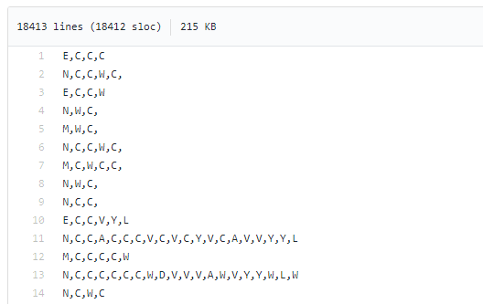

Looking Under the Hood
Mayy’s code
Does not use the provided dataset as input but a different file
Cannot identify individual experiments. The code in Github looks like it’s the code for Experiment 1.

Slide 8
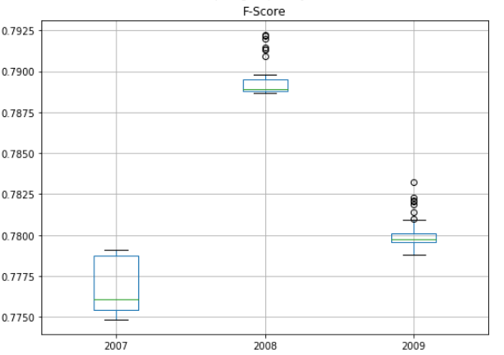
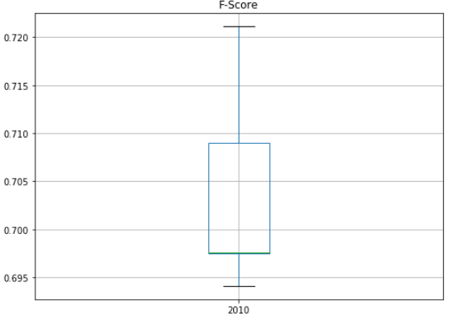
My Experiment
Does order of the training set matter?
Use HMM parameters with same initlizations but shuffle the order of bugs

Slide 9
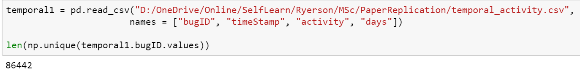
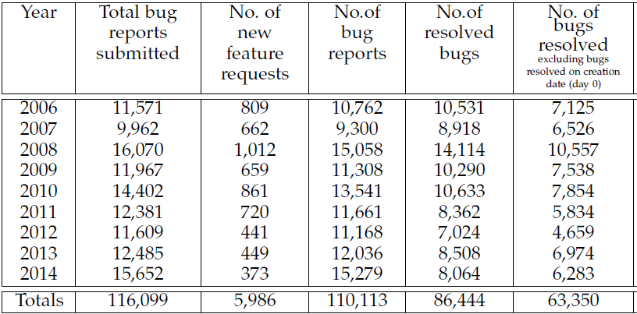
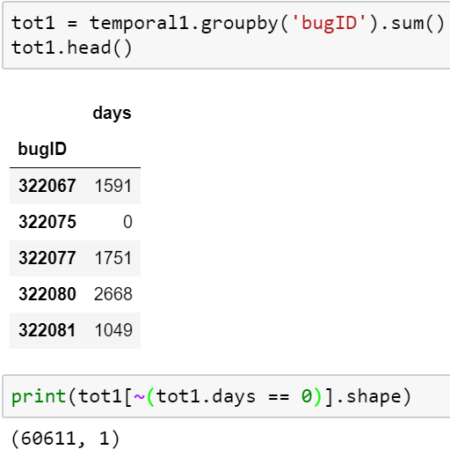
Dataset
Summary statistics do not match
Difference in our definitions for the day 0 bugs
Had the same results in SQL as well

Slide 10
Experiments
Using fixed length sequences for classification
Using first week’s activities to predict the time to fix bugs
Using previous year’s data to predict the time to fix bugs

Slide 11
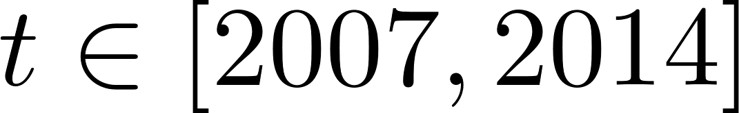
Experiment 3
Can we use year t-1 to predict the bugs in year t?
Threats to replication
For testing, used whole next year to validate results (In the paper they use a portion)
Multiple iterations, reporting the average

Slide 12
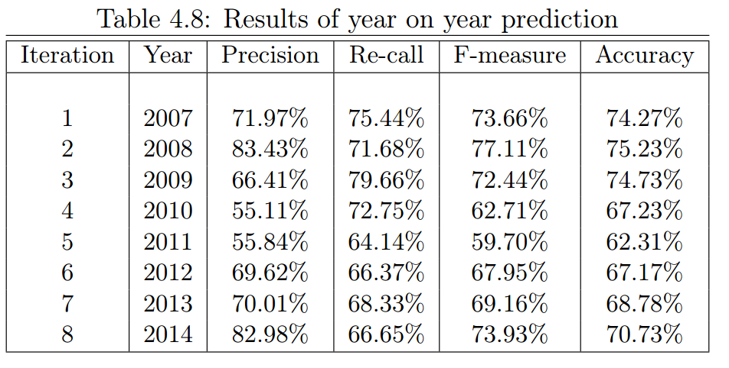
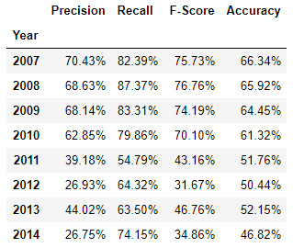
Results: Paper vs Replication

Slide 13
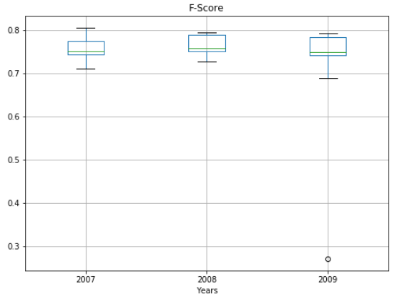
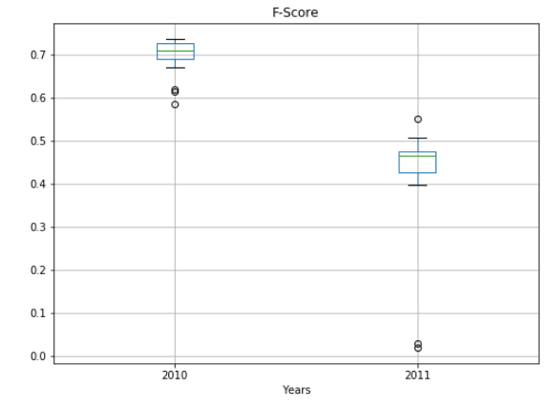
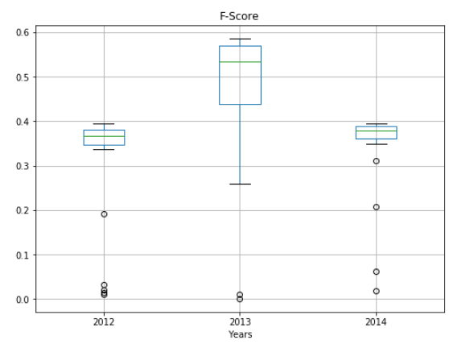
Results

Slide 14
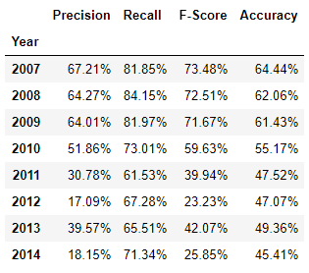
Results: Paper vs Replication
The Arthur Condition: Only include channels that we don’t known to be slow. The cumulative time for first N activities does not exceed 60 days.

Slide 15
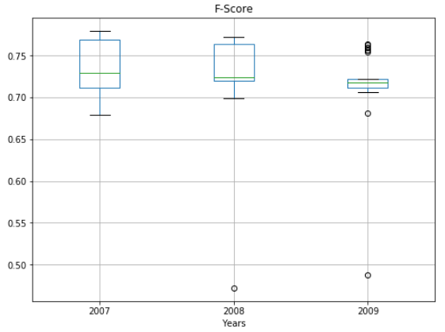
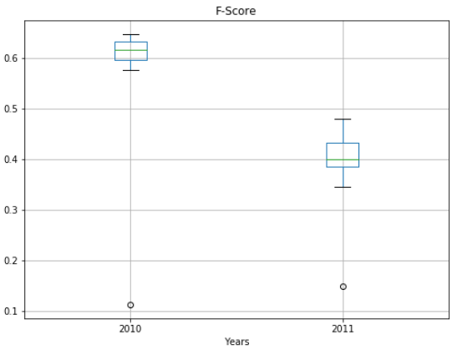
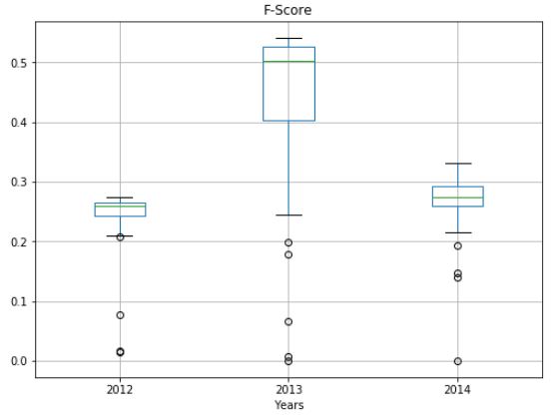
Results

Slide 16
Thank you for listening!

Slide 17
References
[1] Khreich, Wael, et al. "A survey of techniques for incremental learning of HMM parameters." Information Sciences 197 (2012): 105-130.

